Slide 1
Rotating Frame Analysis using Vector Notation
Dr. Agnes d’Entremont
Associate Professor of Teaching
Mechanical Engineering, University of British Columbia

Slide 2
Relative Motion Analysis: rigid/pinned versus sliding/separate
The relative motion analysis using translating coordinate frames works for finding velocities and accelerations of points on rigid bodies that are rigidly connected or pinned together
If one body is sliding with respect to another body (e.g. a box sliding off a rotating ramp), or the two bodies are entirely separate (two airplanes travelling on separate arcs), then we need to use a rotating coordinate frame which rotates with one of the bodies.

Slide 3
Rotating Frames
The most general relative motion equation
Fixed axis rotation and translating frames are special cases
Can always use the rotating frames equation
The most complex relative motion equation
We often use one of the special cases if we can

Slide 4



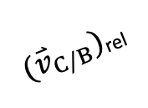





Rotating Frames
When considering relative motion analysis previously, we created a series of coordinate frames that translated (not rotated) with the body.
Now, we need a frame that rotates with the body. We will use x’ and y’ for this frame.
Collar C is sliding against BD.
The rotating frame is attached at B, rotating with BD.
$$y′$$
${(\overset{⃑}{v}}_{C/B})$_{rel}
D
$$x′$$
C
$$ϕ$$
B
$$y_{1}$$
$$Y$$
$$θ$$
$$x_{1}$$
$$X$$
O
A

Slide 5

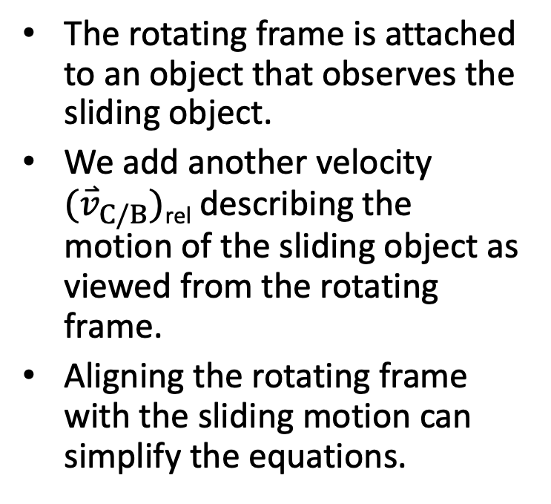
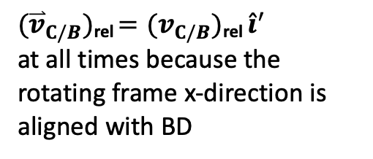
Rotating Frames
The rotating frame is attached to an object that observes the sliding object.
We add another velocity ${(\overset{⃑}{v}}_{C/B})$_{rel} describing the motion of the sliding object as viewed from the rotating frame.
Aligning the rotating frame with the sliding motion can simplify the equations.
Collar C is sliding against BD.
The rotating frame is attached at B, rotating with BD.
$$y′$$
${(\overset{⃑}{v}}_{C/B})$_{rel}
D
$$x′$$
C
$$ϕ$$
B
$$y_{1}$$
$$Y$$
${(\overset{⃑}{v}}_{C/B})$_{rel} $={(v}_{C/B})\text{rel} {\hat{i}}^{′}$
at all times because the rotating frame x-direction is aligned with BD
$$θ$$
$$x_{1}$$
$$X$$
O
A

Slide 6



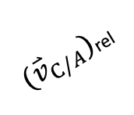

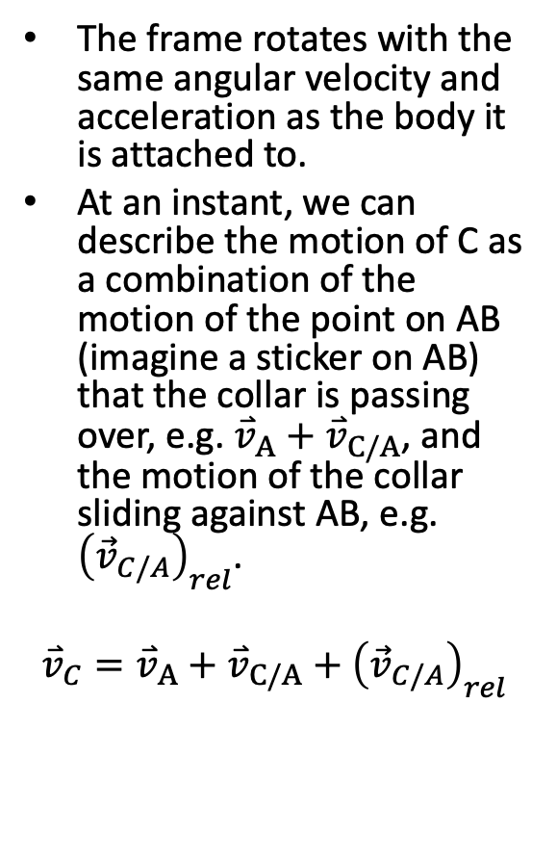


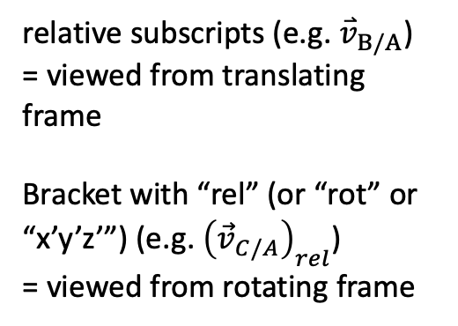





Meaning of Relative Motion Equations
The frame rotates with the same angular velocity and acceleration as the body it is attached to.
At an instant, we can describe the motion of C as a combination of the motion of the point on AB (imagine a sticker on AB) that the collar is passing over, e.g. ${\overset{⃑}{v}}_{A}+{\overset{⃑}{v}}_{C/A}$, and the motion of the collar sliding against AB, e.g. ${\left({\vec{v}}_{C/A}\right)}_{rel}$.
$${\overset{⃑}{v}}_{C}={\overset{⃑}{v}}_{A}+{\overset{⃑}{v}}_{C/A}+{\left({\vec{v}}_{C/A}\right)}_{rel}$$
$$y′$$
$${\overset{⃑}{v}}_{C/A}$$
$$\vec{ω}$$
$$y′$$
$$y′$$
B
$$x′$$
${(\overset{⃑}{v}}_{C/A})$_{rel}
$$x′$$
$$x′$$
$${\overset{⃑}{v}}_{A}$$
A
relative subscripts (e.g. ${\overset{⃑}{v}}_{B/A}$)
= viewed from translating frame
Bracket with “rel” (or “rot” or “x’y’z’”) (e.g. ${\left({\vec{v}}_{C/A}\right)}_{rel}$)
= viewed from rotating frame
$$Y$$
O
$$X$$
CC BY binocular by iconcheese from the Noun Project

Slide 7
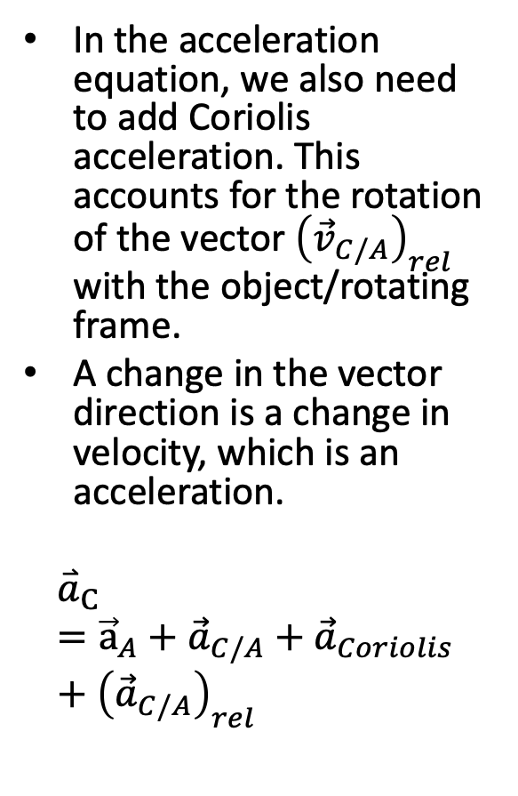
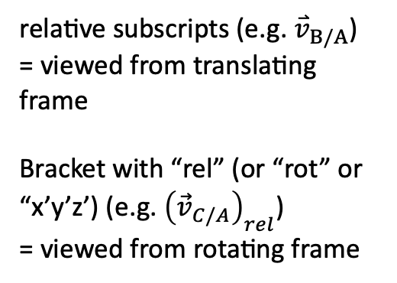
Meaning of Relative Motion Equations
In the acceleration equation, we also need to add Coriolis acceleration. This accounts for the rotation of the vector ${\left({\vec{v}}_{C/A}\right)}_{rel}$ with the object/rotating frame.
A change in the vector direction is a change in velocity, which is an acceleration.
$${\overset{⃑}{a}}_{C}={\vec{a}}_{A}+{\vec{a}}_{C/A}+{\vec{a}}_{Coriolis}+{\left({\vec{a}}_{C/A}\right)}_{rel}$$
$$y′$$
$${\overset{⃑}{v}}_{C/A}$$
$$\vec{ω}$$
$$y′$$
$$y′$$
B
$$x′$$
${(\overset{⃑}{v}}_{C/A})$_{rel}
$$x′$$
$$x′$$
$${\overset{⃑}{v}}_{A}$$
A
relative subscripts (e.g. ${\overset{⃑}{v}}_{B/A}$)
= viewed from translating frame
Bracket with “rel” (or “rot” or “x’y’z’) (e.g. ${\left({\vec{v}}_{C/A}\right)}_{rel}$)
= viewed from rotating frame
$$Y$$
O
$$X$$
CC BY binocular by iconcheese from the Noun Project

Slide 8
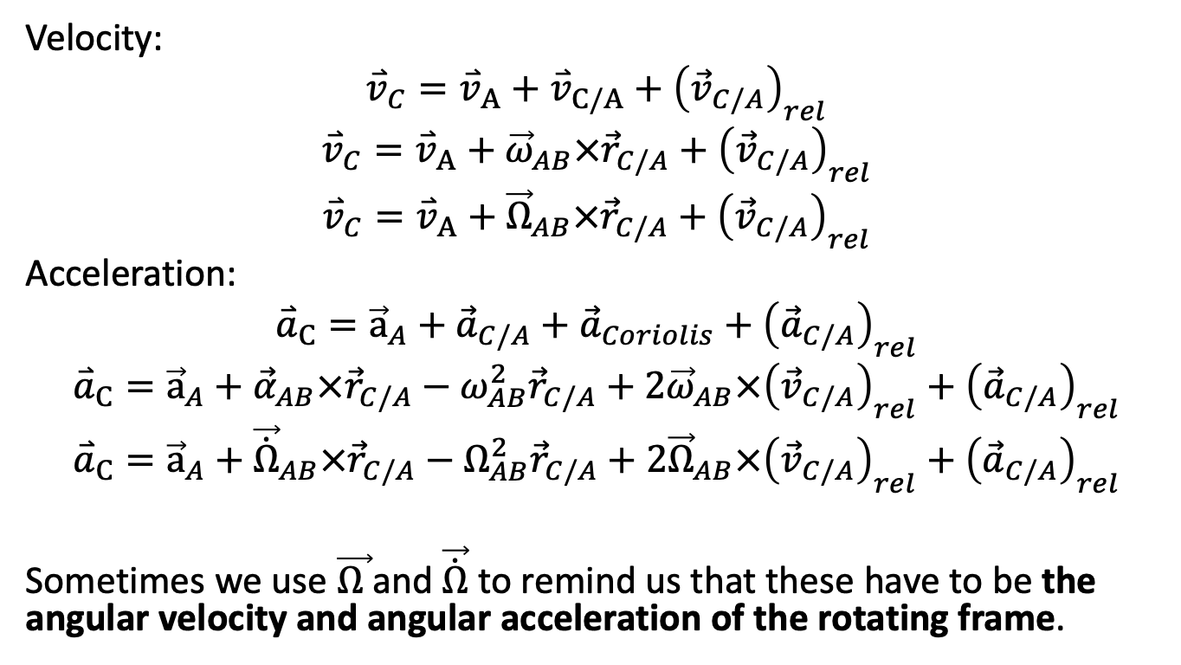
Final rotating frame equations
Velocity:
$${\overset{⃑}{v}}_{C}={\overset{⃑}{v}}_{A}+{\overset{⃑}{v}}_{C/A}+{\left({\vec{v}}_{C/A}\right)}_{rel}$$
$${\overset{⃑}{v}}_{C}={\overset{⃑}{v}}_{A}+{\vec{ω}}_{AB}×{\vec{r}}_{C/A}+{\left({\vec{v}}_{C/A}\right)}_{rel}$$
$${\overset{⃑}{v}}_{C}={\overset{⃑}{v}}_{A}+{\vec{Ω}}_{AB}×{\vec{r}}_{C/A}+{\left({\vec{v}}_{C/A}\right)}_{rel}$$
Acceleration:
$${\overset{⃑}{a}}_{C}={\vec{a}}_{A}+{\vec{a}}_{C/A}+{\vec{a}}_{Coriolis}+{\left({\vec{a}}_{C/A}\right)}_{rel}$$
$${\overset{⃑}{a}}_{C}={\vec{a}}_{A}+{\vec{α}}_{AB}×{\vec{r}}_{C/A}−ω_{AB}^{2}{\vec{r}}_{C/A}+2{\vec{ω}}_{AB}×{\left({\vec{v}}_{C/A}\right)}_{rel}+{\left({\vec{a}}_{C/A}\right)}_{rel}$$
$${\overset{⃑}{a}}_{C}={\vec{a}}_{A}+{\vec{\dot{Ω}}}_{AB}×{\vec{r}}_{C/A}−Ω_{AB}^{2}{\vec{r}}_{C/A}+2{\vec{Ω}}_{AB}×{\left({\vec{v}}_{C/A}\right)}_{rel}+{\left({\vec{a}}_{C/A}\right)}_{rel}$$
Sometimes we use $\vec{Ω }$and $\vec{\dot{Ω}}$ to remind us that these have to be the angular velocity and angular acceleration of the rotating frame.

Slide 9
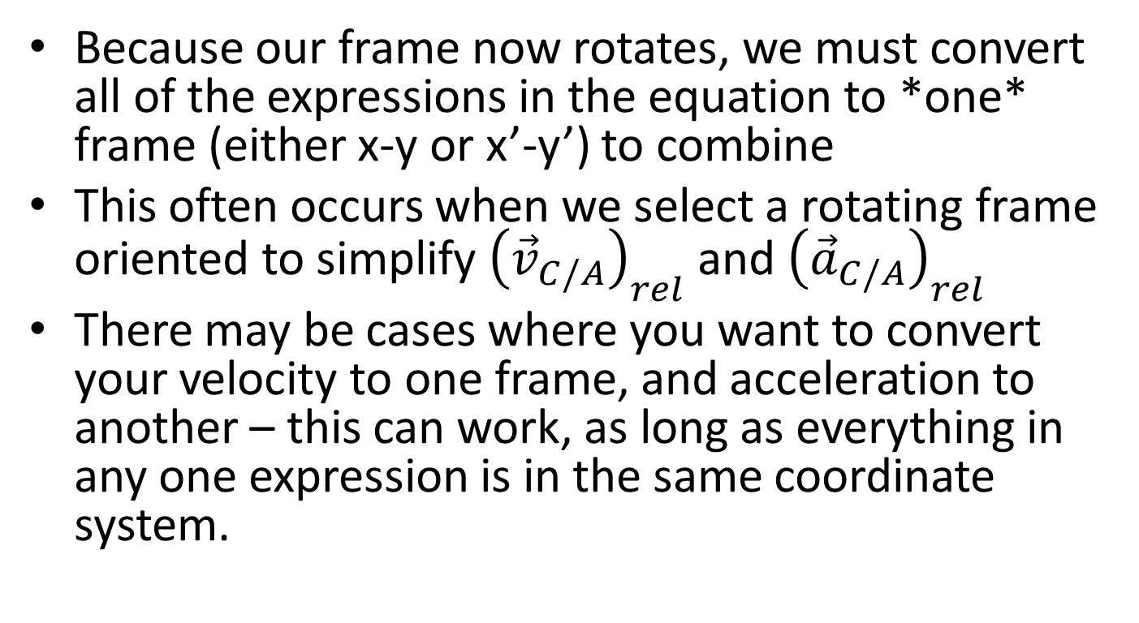
Dealing with Multiple Coordinate Systems
Because our frame now rotates, we must convert all of the expressions in the equation to *one* frame (either x-y or x’-y’) to combine
This often occurs when we select a rotating frame oriented to simplify ${\left({\vec{v}}_{C/A}\right)}_{rel}$ and ${\left({\vec{a}}_{C/A}\right)}_{rel}$
There may be cases where you want to convert your velocity to one frame, and acceleration to another – this can work, as long as everything in any one expression is in the same coordinate system.

Slide 10
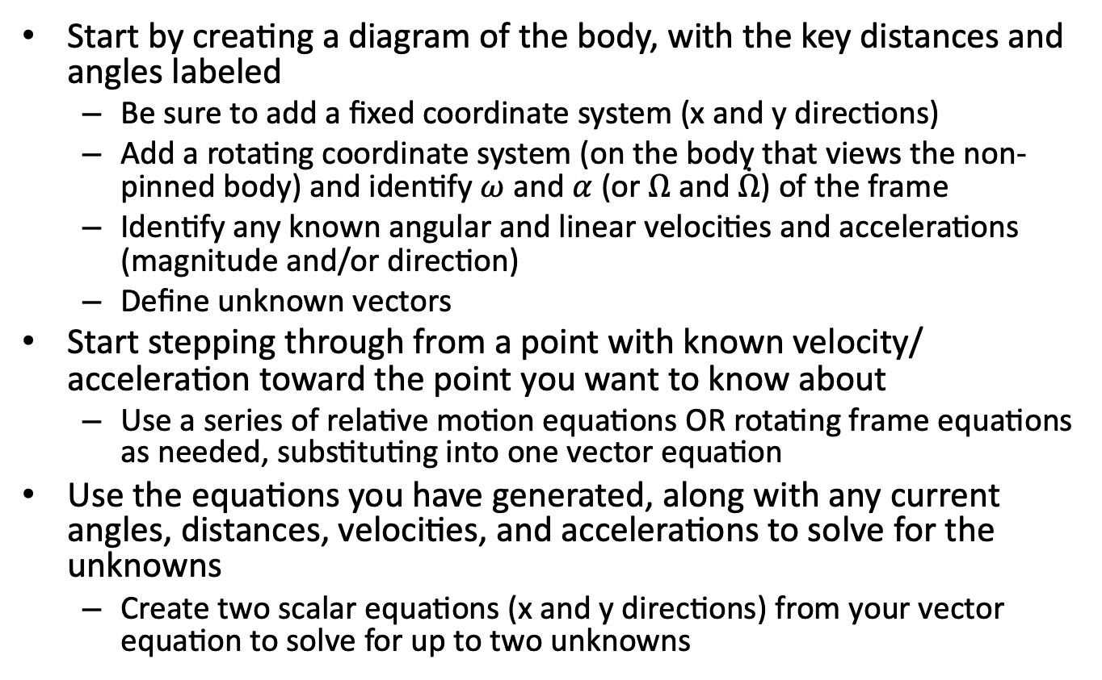
Rotating Frames Analysis Process
Start by creating a diagram of the body, with the key distances and angles labeled
Be sure to add a fixed coordinate system (x and y directions)
Add a rotating coordinate system (on the body that views the non-pinned body) and identify $ω$ and $α$ (or $Ω$ and $\dot{Ω}$) of the frame
Identify any known angular and linear velocities and accelerations (magnitude and/or direction)
Define unknown vectors
Start stepping through from a point with known velocity/ acceleration toward the point you want to know about
Use a series of relative motion equations OR rotating frame equations as needed, substituting into one vector equation
Use the equations you have generated, along with any current angles, distances, velocities, and accelerations to solve for the unknowns
Create two scalar equations (x and y directions) from your vector equation to solve for up to two unknowns

Slide 11
Hints for Rotating Frames
Think about placement/orientation of your rotating frame to reduce the algebra work in your solution
Write out the whole equation, and make sure you don’t miss any terms
Be clear in each equation which frame (xyz or x’y’z’) is being used
Take your time with this analysis – it can be challenging

Slide 12
Thanks for Watching
See other engineering mechanics videos and access the full tool at…

Slide 13
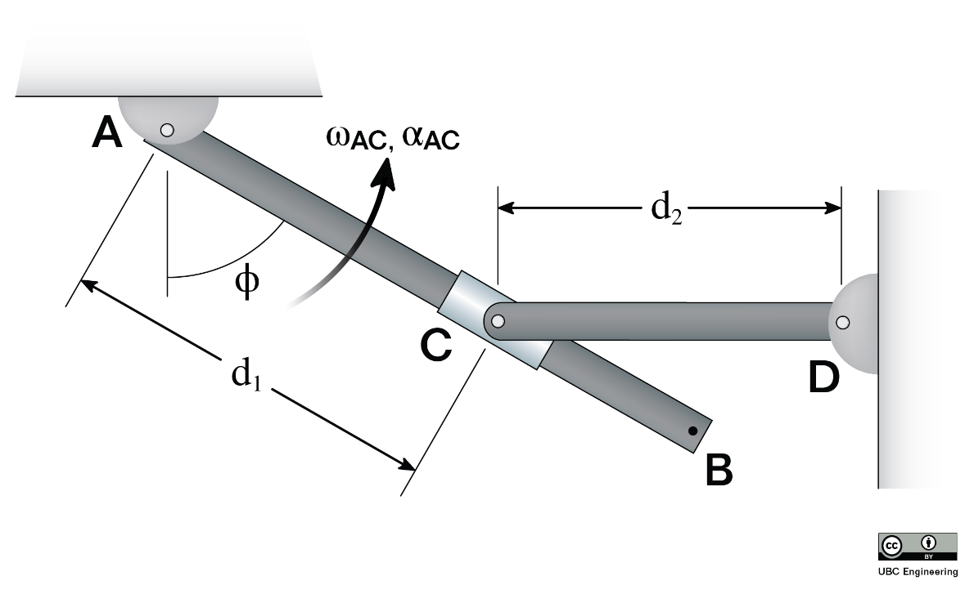
Worked Example
A collar which is pinned to rod CD slides along rod AB. At the instant shown, when ϕ=60 deg, the angular velocity of rod AB is 2 rads/s in the direction shown. Find the rate at which C travels along rod AB, and the angular velocity of rod CD. Assume d₁ = 0.3 m and d₂ = 0.2 m.

Slide 14
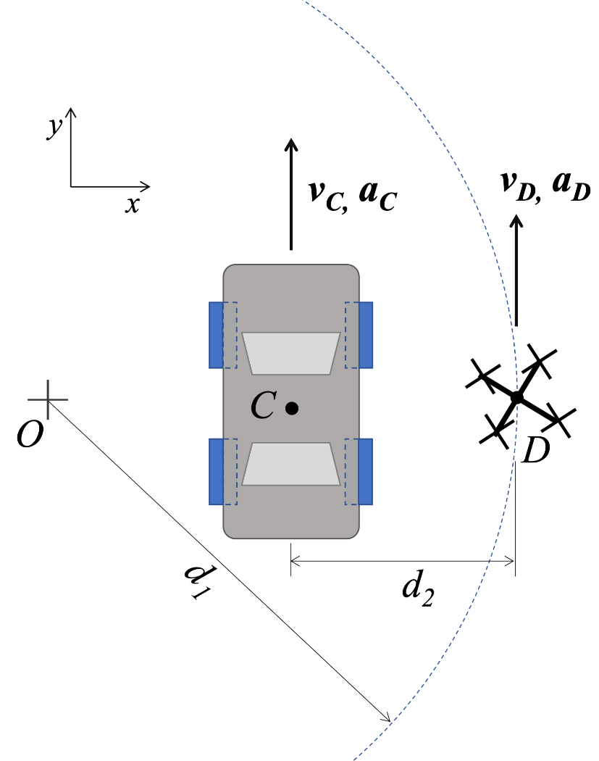
Worked Example
A camera drone, D, flies over a car race in a curved trajectory (centre O) with a constant ground-speed velocity of v_{D} = 9 m/s. At the moment shown, car C is travelling with velocity of v_{C} = 12 m/s and an acceleration of a_{C} = 2 m/s² as shown. Assume d₁ = 7.5 m, d₂ = 3 m.
Find the velocity of the car as observed by the camera on drone D at this instant.
Find the acceleration of the car as observed by the camera on drone D at this instant.

Slide 15
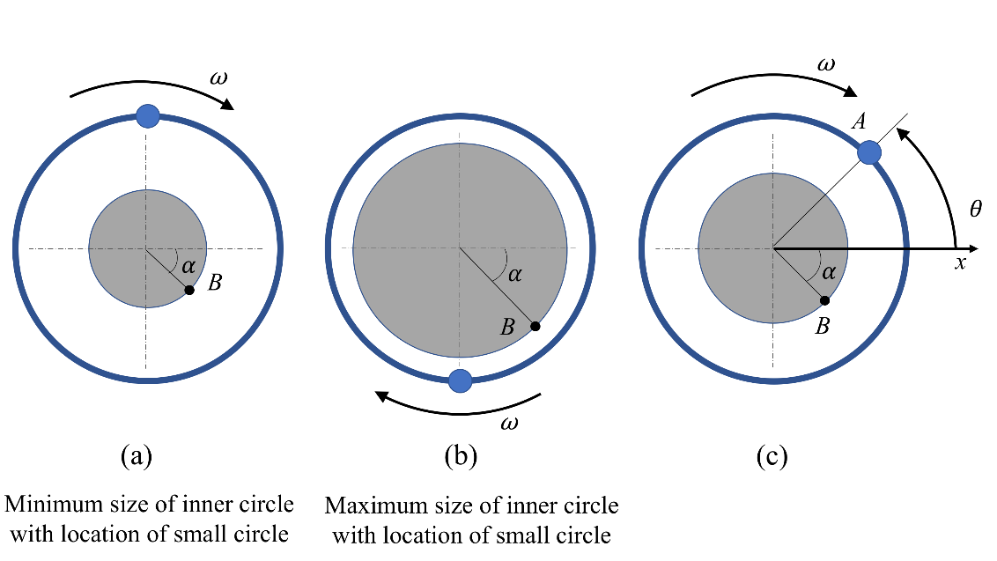
Worked Example
A breathing exercise video graphic (somewhat similar to this one) shows a small circle moving in a constrained circular path (constant radius 80 cm) at a constant angular velocity of 0.4 rad/s around an expanding and contracting inner circle. The inner circle expands and contracts sinusoidally, from a minimum radius of 30 cm to a maximum radius of 60 cm. The distance from the centre of the inner circle to a point on the edge of the inner circle can be described by the equation r=0.45-0.15 sin⁡θ (in m), where θ is the position of the small circle (zero at x-axis).
Find the velocity and acceleration of point B on the edge of the inner circle as viewed by an observer on the small circle at point A (Fig. (c)). θ=45°, α=45°

Slide 16
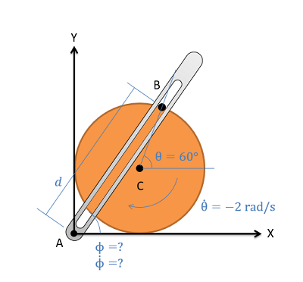
Worked Example
The crank-rocker mechanism as shown below consists of a crank with a radius of .5 meters rotating about its fixed center at C at a constant rate of 2 rad/s clockwise. Rocker AB fixed at it's base at A and connects to point B along the edge of the crank. The pin at point B can slide along a frictionless slot in AB. In the current state, what is the angular velocity of rocker AB?

Slide 17
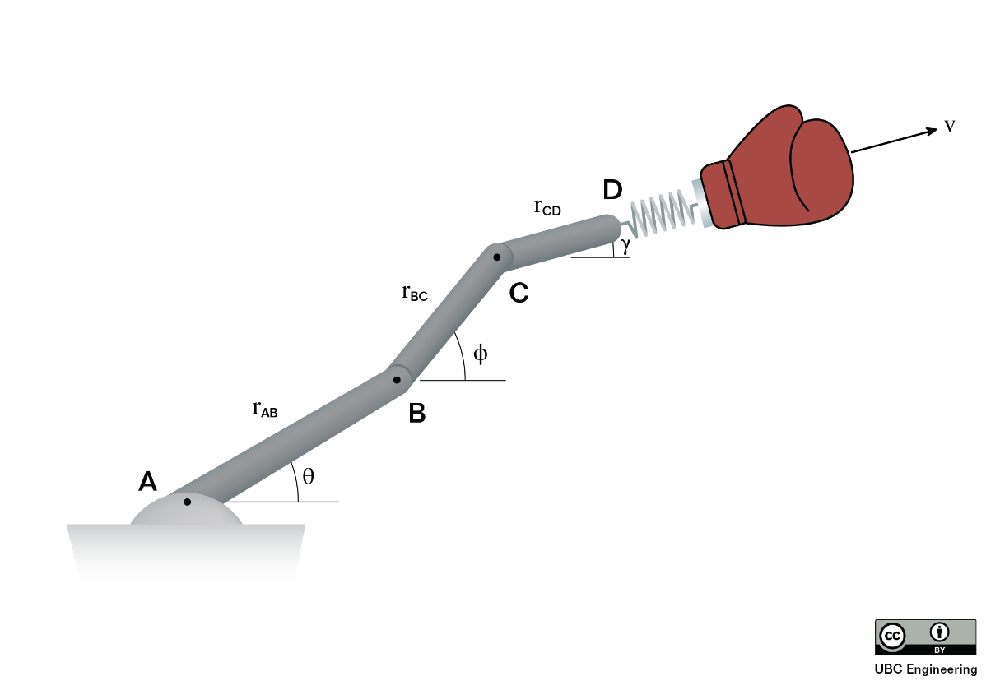
Worked Example
A very funny engineer has attached her prank punching machine to a robotic arm. If the boxing glove moves at a maximum 1m/s constant velocity, relative to the link CD, what is the velocity and acceleration of the glove at the instant shown? The lengths of the linkage arms are given as r_{AB}=0.3 m, r_{BC}=0.6 m and r_{CD}=0.4 m. The angles are given as θ=30 deg, Φ=50 deg and γ=15 deg. Arm BC is rotating at ω_{BC}=2 rad/s and α_{BC}=1 rad/s^2, while arm CD is rotating at ω_{CD}=-0.25 rad/s and α_{CD}=0.25 rad/s². Arm AB is stationary throughout.

Slide 18
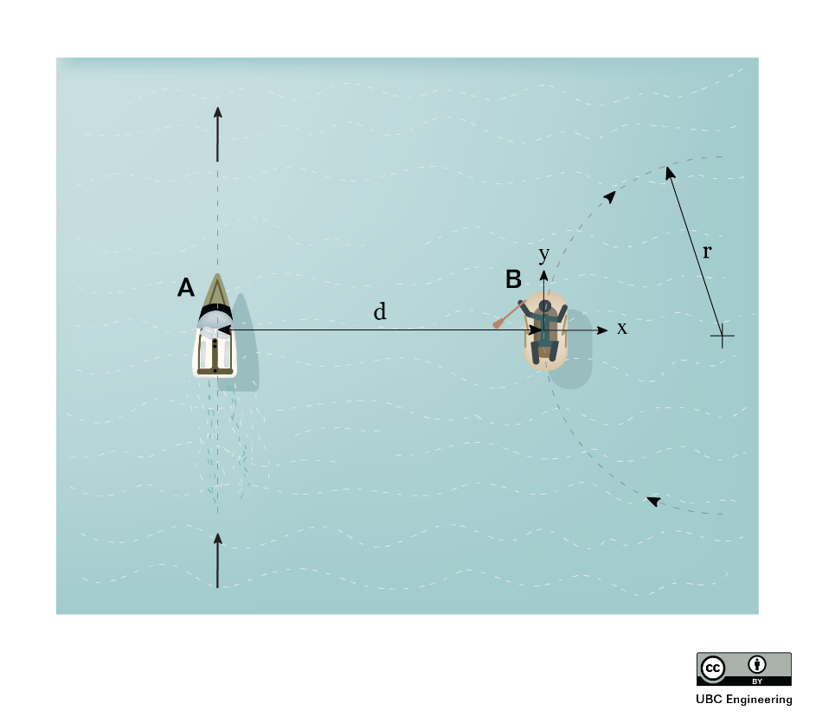
Worked Example
Boat A is travelling forward (in positive y) with a velocity of 25 m/s and an acceleration of 4 m/s2. The person in dingy B is travelling in a circle (as they only have one oar). They have a forward (in positive y) velocity of 5 m/s and acceleration of -1 m/s2 (as they have lost focus while watching boat A). The radius of dingy B’s path is r = 20 m, and the distance between the vessels is d = 10 m.
Find the velocity and acceleration of boat A as seen by the occupants of dingy B.

Slide 19
Worked Example
Boat A is travelling forward (in positive y) with a velocity of 25 m/s and an acceleration of 4 m/s2. The person in dingy B is travelling in a circle (as they only have one oar). They have a forward (in positive y) velocity of 5 m/s and acceleration of -1 m/s2 (as they have lost focus while watching boat A). The radius of dingy B’s path is r = 20 m, and the distance between the vessels is d = 10 m.
Find the velocity and acceleration of dingy B as seen by the occupants of boat A.

Slide 20
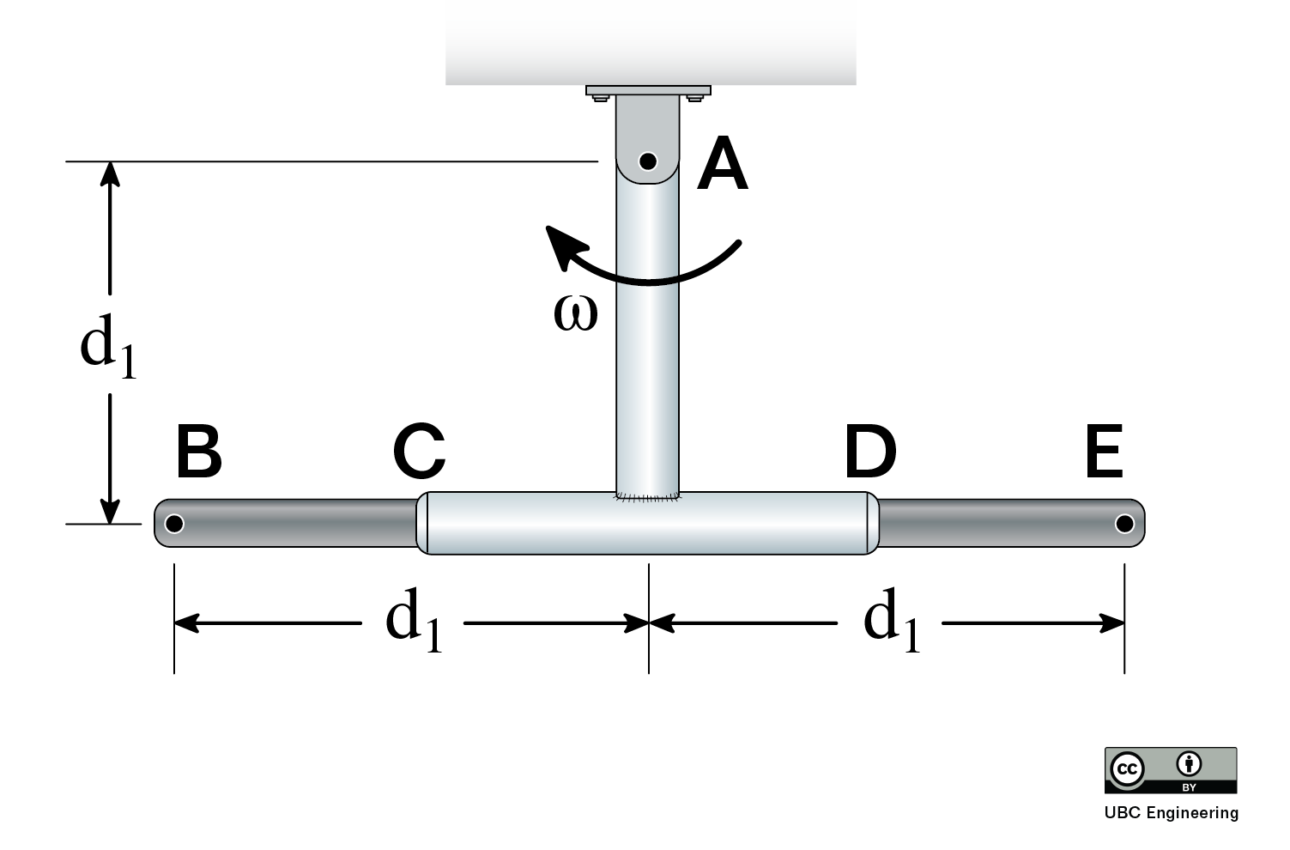
Worked Example
Body ACD is pinned at A and is rotating with an angular velocity of ω = 3 rad/s as shown at this instant. Bar BE slides through tube CD, such that, at this instant, the velocity of B is purely in the y-direction, and the acceleration of B is zero (as observed from the fixed frame). Find the vectors for the velocity and acceleration of B in the rotating frame, (v_{B/A})_{x'y'z'} and (a_{B/A})_{x'y'z'}, and the angular acceleration of ACD at this instant. Distance d₁ = 0.5 m.

